Slide 1

The gateway theory and e-cigarettes
Prof. Jean-François ETTER PhD (political science)
TOPS: Tobacco Online Policy Seminar
September 4, 2020
Based on: Etter JF. Gateway effects and electronic cigarettes. Addiction 2018;113: 1776-1783. https://doi.org/10.1111/add.13924

Slide 2
Disclosure
Source of funding: None. JFE’s salary is paid by the University of Geneva.
Tobacco-related funding sources over the last 10 years None.
In 2013, I was reimbursed by an e-cigarette company for travelling to China. The aim of this meeting was mutual information, and a visit of e-cigarette factories.

Slide 3
The gateway theory
Hybrid of popular, academic and media accounts
Since 1970s: used to support the idea that marijuana causes heroin use
Has always been controversial

Slide 4
Why does the gateway theory matter?
It has enormous political influence
EU Tobacco Products Directive states that: “Electronic cigarettes can develop into a gateway to nicotine addiction and ultimately traditional tobacco consumption […]. For this reason, it is appropriate to adopt a restrictive approach”
Central argument of opponents to new vaporization technologies, who argue that e-cigs could also be a gateway to illicit drug use

Slide 5
Establishing causality: Austin Bradford Hill, 1965
9 aspects or “viewpoints”:
1. Strength of the association
2. Consistency (across trials, investigators, persons, replications)
3. Specificity (can other things cause it?)
4. Temporal precedence (do we know if cause precedes effect)
5. Dose-responsivity
6. Plausibility (biological and psychological)
7. Coherence (consistent with other lines of evidence)
8. Experiment
9. Analogy (do similar agents act similarly)
Reference

Slide 6
Experiment
Not feasible
So, we need good longitudinal observational studies with: - reliable assessments of behaviors - at the right time (to assess antecedence) - assess smoking uptake, a non-repeatable event - comprehensive measurement of confounders - sophisticated analyses to eliminate the effect of confounders
But… … data = mostly self reports by teens, unreliable … even small rates of misclassification may impede adjustment for confounders

Slide 7
Strength of the association
Effects will need to be large to be detectable because measures are imprecise
Doubt that small effects can ever be detected in observational studies largely based on questionnaires in teenagers
Relatively few non-smokers have taken up vaping => population effect (relative risk applied to number of users) is likely to be small But this may change with new products (e.g. nicotine salts, high nico. levels)

Slide 8
Consistency across trials, methods, investigators, populations
Wide variations of results - good predictor: the author’s past publications + opinion - ideological bias (on both sides)
E-cig = not a single product, but a wide variety of products, constant flow of new products, very innovative sector
Youth e-cig use depends on factors that vary geographically and over time : - product characteristics, innovation - nicotine content and delivery - access, product availability - marketing, social media - regulation - information to the public - social context, prevalence of vaping and smoking - anti-smoking policies
Thus, results of studies : - may not be generalizable, - are rapidly obsolete - are often unreliable

Slide 9
Specificity (exclude that other things cause smoking)
Proximity of the 2 behaviors: use of any nicotine device is inevitably associated with use of other nicotine devices
Common susceptibility to both vaping and smoking:
Social influences, family and friends who smoke and/or vape
Personality (risk taking, novelty seeking)
Use of other tobacco products
Use of other drugs
Behavioral problems
Psychiatric problems
Genetic factors

Slide 10
Specificity : the common liability theory
Statistical adjustments do not eliminate the variability in propensity to smoke captured by the variable ‘‘e-cig use’’
=> Vaping will still predict smoking in the best multivariate models
The unavoidable presence of residual confounding is a very important point in this context.
The common liability theory:
Is supported by a large body of scientific evidence
Also accounts for the dose-response effects
Provides a good foundation for research and policy

Slide 11
Temporality
Cause must precede effect
It is very hard to establish antecedence when product use co-occur
Reliability of self-reports of past behavior by teenagers?
The sequence of product use can be explained by the sequence of opportunities to use these products, rather than by an inherent capacity of vaping to cause smoking
Several longitudinal studies have found that non-smokers who use e-cigs are more likely than non-users to start smoking at follow-up, but these studies document 2 criteria only: - antecedence and - increased relative risk of smoking

Slide 12
Antecedence and increased risk: not sufficient
Establishing antecedence and increased risk is not sufficient, because it does not eliminate : - confounding by other factors (even after statistical adjustment) - doubts about the plausibility of the gateway theory
Many of these studies used data collected for other purposes, and did not measure all the relevant confounders
Most longitudinal studies fail to report or measure the duration + intensity of vaping before subsequent smoking
The subsequent smoking is often experimentation rather that regular smoking

Slide 13
Plausibility: yes
Gestures, inhalation
Route of administration model
Contact with smokers in smoking / vaping outdoors areas
Changes in the brain (nicotinic receptors)
Addiction to nicotine but : - most current e-cig models are not very addictive, although this may change with recent models (nicotine salts) - if nicotine supply is not sufficient, instead of smoking, vapers can switch to newer e-cig models that provide more nicotine, or more concentrated liquids

Slide 14
Plausibility: no
Cigarettes are omnipresent, there is no need for a gateway device
Why would people who chose to vape rather then smoke change their mind and start smoking ?
In fact smoking usually precedes vaping: this is a solid fact against the gateway theory
Reverse gateway: people vape because they look for alternatives to smoking that are safer, cheaper, more socially acceptable

Slide 15
Coherence : consistent with other lines of evidence ?
Is the theory coherent with historical trends in vaping and smoking ?
There is a decrease is youth smoking prevalence in countries where vaping is frequent (US, UK).
This trend accelerates in the US after 2014, when vaping became popular

Slide 18
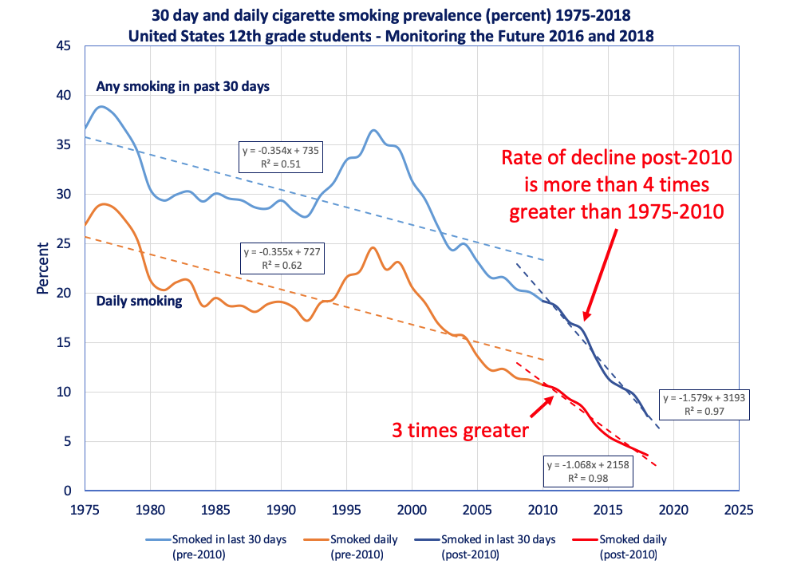
Source

Slide 19
Coherence : consistent with other lines of evidence ?
Decrease is youth smoking prevalence in countries where vaping is frequent:
This is reassuring, but smoking prevalence data are no proof for of against the gateway theory
Teens also drink less, start sex later : perhaps because of mobile phone + social networks ?

Slide 20
Analogy : do similar agents act similarly ?
Nicotine medications
Are not very addictive
No reported case of non-users of tobacco who got addicted to nicotine medications and then switched to smoking to satisfy this addiction
Smokeless tobacco
Delivers large amounts of nicotine and is addictive
Reviews say smokeless does not appear to be a gateway to smoking
Smoking prevalence is low in countries where smokeless is legal and popular (e.g. Sweden)

Slide 21
Alternative explanations
Spurious gateway effects can be artificially created in mathematical models in which a propensity to use substances is correlated with opportunities to use them
Simulation models demonstrate that the three core elements of the gateway theory (temporal sequence, increased risk and dose-response) can be artificially produced in a situation where any causal gateway effect is excluded by design (Morral A. Addiction 2002: 97: 1493)
Common liability theory applies: people smoke or vape because they are liable to use nicotine, in any form
It is difficult to completely eliminate residual confounding
Gateway theory and common liability theory are not mutually exclusive
Common liability may explain the initiation of the sequence, while progression to regular use may depend on enabling + reinforcing factors (availability, inhalation practice) which may have a causal effect on subsequent smoking

Slide 22
UK Royal College of Physicians report, 2016
U.K. Royal College of Physicians 2016:
“ the available evidence to date indicates that e-cigarettes are being used almost exclusively as safer alternatives to smoked tobacco, by confirmed smokers who are trying to reduce harm to themselves or others from smoking, or to quit smoking completely.”
“ it appears that, to date, concerns over gateway progression into smoking are unfounded. The association between e-cigarette and tobacco cigarette use is therefore more likely to arise from common liability to use of these products ” (p. 128)
Reference

Slide 23
Public Health England report, 2018 update
Public Health England report, 2018 update: “ Despite some experimentation with EC among never smokers, EC are attracting very few people who have never smoked into regular EC use.”
“ Never smokers in the UK who try e-cigarettes are more likely to have tried smoking subsequently than those who have not tried e-cigarettes. A causal link has not been established and neither has progression to regular smoking. The ‘common liability’ hypothesis seems a plausible explanation for the relationship between e-cigarettes and smoking implementation.”
Reference

Slide 24
USA: NASEM report, 2018
US National Academies of Science, Engineering and Medicine 2018:
“ There is substantial evidence that e-cigarette use by youth and young adults increases their risk of ever using conventional cigarettes.”
Moderate evidence that e-cigarette use increases the frequency and intensity of subsequent combustible tobacco cigarette smoking [16-2]
Limited evidence that e-cigarette use increases, in the near term, the duration of subsequent combustible tobacco cigarette smoking [16-3]
But … NASEM report also says (though this was less frequently cited / commented on) : “it is unclear whether this increase in ever use results in an increased adult initiation rate” (p. 19.3, last paragr.)
Reference

Slide 25
We need comprehensive causal models
The gateway theory is too narrowly focused on just one pathway
We need comprehensive causal models that explain movement in all directions, not just from vaping to smoking
We need complex, multidirectional causal models that allow for a non-linear sequence of behavior over time
Calling any causal model a gateway model reflects a selective, partial, polemical view of this complex question
Reference

Slide 26

Nicotine and tobacco products: a harm reduction approach
None NRT Combustion
Vaporisers
Oral tobacco

Slide 27




Consider the impact of policy measures on all flows and stocks
NRT, e-cig
None
(never user or ex-user)
Combustion
Oral tobacco / heated tobacco
D. Abrams et al.

Slide 28
Types of studies needed
There is no need for more (heavily advertised) studies of antecedence + increased relative risk based on secondary analyses of existing surveys
We need a variety of study types :
Large, specifically designed longitudinal studies that measure confounders repeatedly, and assess the onset of smoking, a non-repeatable event
Studies based on propensity scoring: does vaping predict smoking above a measure of liability to smoke? (approach used for smokeless)
Randomized trials of vaping cessation in young non-smokers (feasible?)
Natural experiments testing the effects of regulations (e.g. ban on sales)
Intervention studies that test the effect of education (does delaying age at first e-cig use delay smoking onset?)
Studies of twins discordant for vaping and smoking, that test for the interactive effects of genes and environment
Experiments in animals, using realistic nicotine doses that reflect real vaping

Slide 29
Balance between the interests of current adult smokers and those of young non-smokers
E-cig most probably help smokers quit, even though the quality and generalizability of much of the evidence is low (RCP, PHE and NASEM reports, Hajek’s RCT, Cochrane review)
Gateway effects would need to be very large to counteract the effects of e-cigs on smoking cessation
K. Warner : in the US, smoking initiation today is unlikely to cause much health damage in 40 years (because smoking prevalence is likely to decline further), and thus it is more urgent to decrease the number of current smokers
No consensus on the level of population risk above which action is required.
Passionate debate on gateway effect, some ask for stringent regulation
Potential adverse effects of these regulations on adult smokers: fewer smokers will switch to vaping if, for example, flavors or nicotine levels are restricted

Slide 30
Trade-off
Stringent measures may decrease the (already very low) number of young non-smokers who : 1) use e-cigs and 2) will subsequently become smokers because of vaping and would not otherwise have smoked regularly
At the cost of many more current smokers who will never switch to vaping, or will stop vaping and relapse to smoking
Challenge: - maximize N smokers who switch, - minimize N non-smokers who use vaporizers
Which is the priority ?

Slide 31
Conclusions (1)
Experts strongly disagree
It is difficult to obtain evidence
Many of the criteria for causality are not met
Youth uptake is currently low, but this may change
Common liability model is plausible, is a good base for policy, but a causal pathway may exist (inhalation, gestures, nicotine addiction, contact with smokers)
If there is a gateway effect, the best response is to reduce youth access to cigarettes (rather than access to reduced harm products)
And should teenage smokers be excluded from harm reduction strategies ?

Slide 32
Conclusions (2)
The gateway theory has enormous political influence
Its success is perhaps due to its simplicity and its efficacy in the political / ideological struggle
Policies based mainly on the gateway theory that do not take sufficient account of their effects on current smokers and of the common liability theory : - may not produce the intended effects in young non-smokers - may produce adverse effects in current smokers, and - by maintaining a high prevalence of adult smoking, they may also maintain a high rate a smoking initiation in teens

